Slide 1
2nd grade
2nd grade
memory book
2019-2020

Slide 2
all about me
all about me
my life in
Age:
Birthday:
Siblings:
Pets:
numbers
Who dreams of
Who hopes for
Who loves

Slide 3

my favorites
my favorites
SUBJECT
COLOR
FOOD
SINGER
MOVIE
FIELD TRIP
SPECIAL AREA

Slide 4
my friends
my friends
Can you match each friend to a box?
BEST ATTENDANCE
FASTEST RUNNER
HIGHEST JUMPER
LONGEST HAIR
NEATEST DESK
FUNNIEST
KINDEST
MOST TALKATIVE
QUIETEST
BEST LUNCHES
BEST LAUGH
BEST HANDWRITING
BEST ARTIST
BEST SINGER
BEST DANCER
BOOK LOVER
MATHEMATICIAN
MOST ACTIVE
TALLEST

Slide 5
my classroom
my classroom
Describe our classroom.
my favorite place in our room:
my shoulder partner was:

Slide 6

my future
my future
1
2
3
future career
#GOALS

Slide 7
my teacher
my teacher
one thing I love about my teacher is
My teacher always says:
something people should know about her is

Slide 8

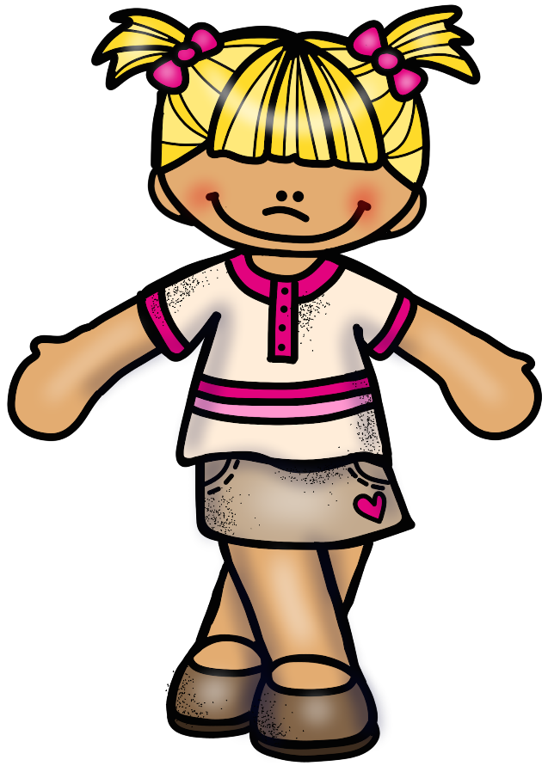

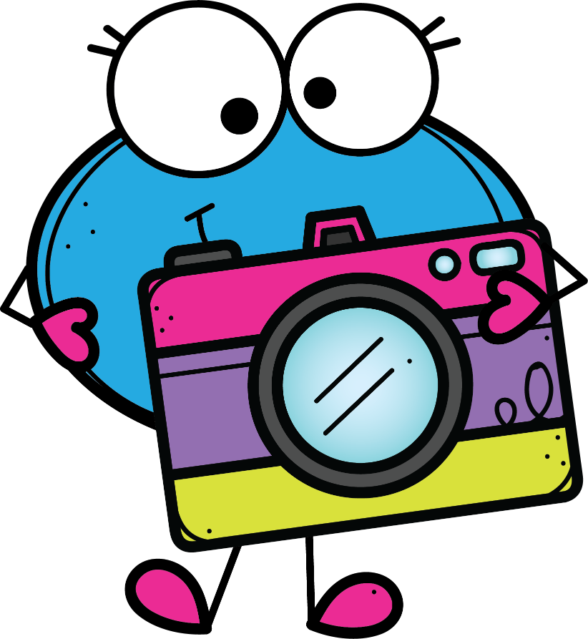
snapshots
snapshots
oh snap!
proudest moment!
accomplishment!
biggest challenge
I felt proud of myself when…
My biggest accomplishment this year was when…
The biggest challenge I overcame this year was when…

Slide 9
Best times
Best times
time with family
time with friends
time at school
My favorite memory with my family this year was when…
My favorite memory with my friends this year was when…
My favorite memory at school
this year was when…

Slide 10
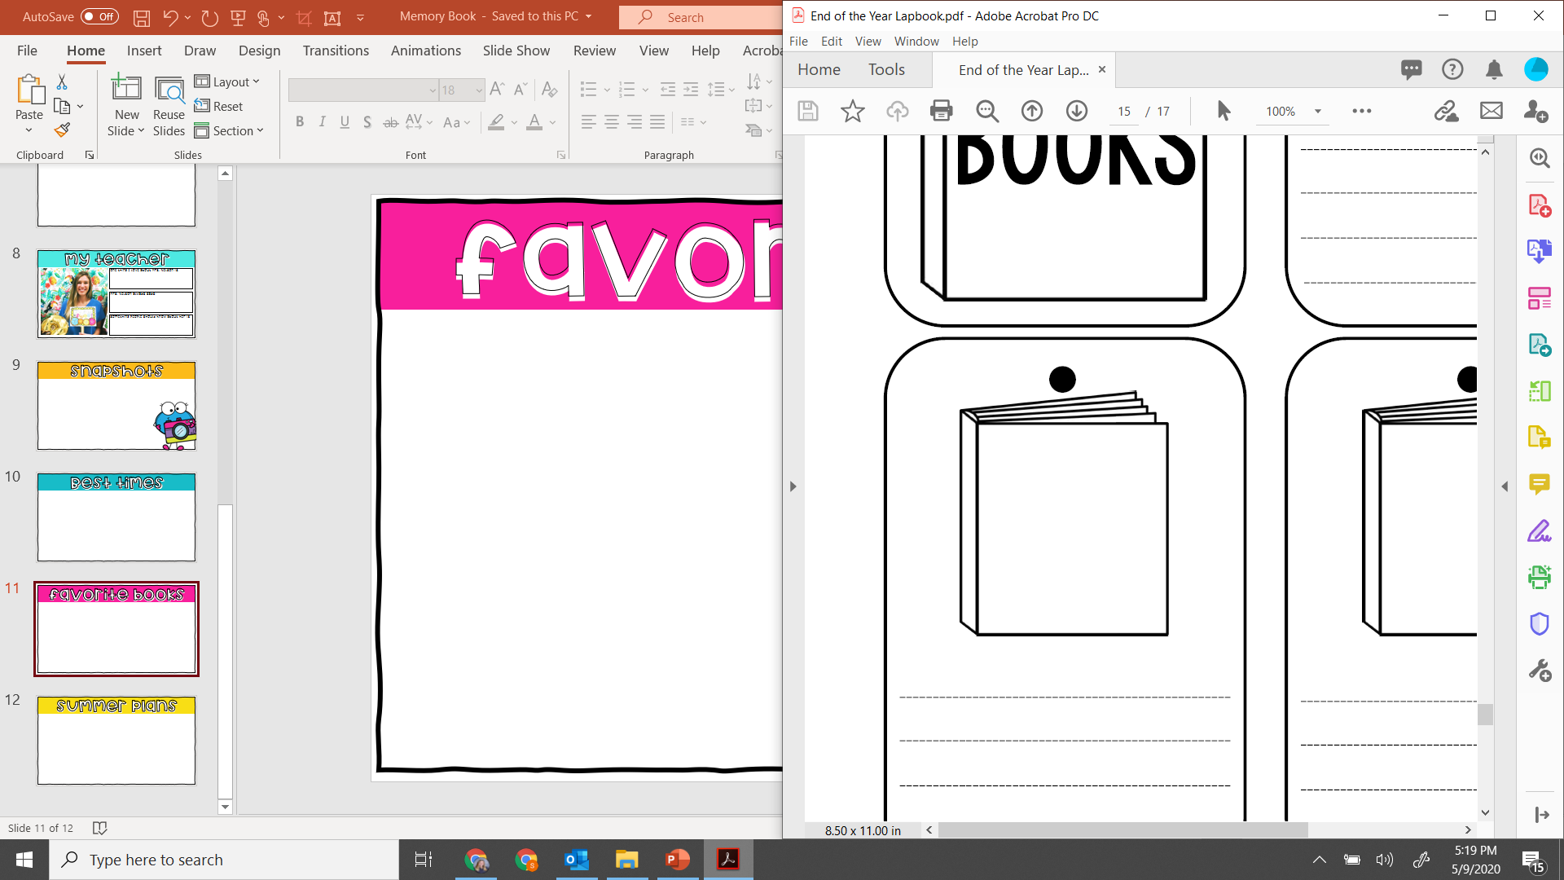
favorite books
favorite books

Slide 11



summer plans
summer plans

